Slide 1
HIV
A Journey of Hope through The Perfect Storm
Presented at the Sixth Tri-Divisional HIV/AIDS meeting September 2013
by Allan R. Handysides M.B.,Ch.B.. FRCPC, FRCSC, FACOG.
Taken from the book by Jacques Pepin
The Origins of AIDS

Slide 2
AIDS
ITS OFFICIAL BIRTHDAY IS JUNE 5 1981 BUT THE RETROSPECTOSCOPE PERMITS A MORE DETAILED PROBING OF ITS ORIGINS
Notes:
IN LOS ANGELES AS IN MUCH OF AMERICA ,HOMOSEXUALS HAD BEEN PROTESTING THE HOMOPHOBIC ATTITUDES AND ACTIONS OF A MAJORITY AND L.A. WAS A CENTER FOR THEM TO CONGREGATE. PART OF THEIR PROTEST HAD MANIFEST IN OVERT PROMISCUITY.
THIS HAD MULTIPLE RAMIFICATIONS, AND SO IT WAS THAT ON JUNE 5 1981 IN THE MORTALITY AND MORBIDITY REPORTS (MMR), (THE WEEKLY PUBLICATION OUT OF THE CENTERS FOR DISEASE CONTROL) THERE APPEARED AN ARTICLE DESCRIBING AN ACQUIRED IMMUNODEFICEINCY DISORDER IN 5 HOMOSEXUAL MALES.
THUS WAS BORN THE MODERN UNDERSTANDING OF A NEWLY RECOGNIZED DISEASE; BUT NEW IT WAS NOT AS WE SHALL SEE TODAY

Slide 3

PNEUMOCYSTIS CARINII
Notes:
WHAT HAS NOT OFTEN BEEN REPORTED WAS THAT THE REPORT FOLLOWED THE INVESTIGATION OF THE FINDINGS OF AN ASTUTE CDC TECHNICIAN WHO HAD NOTICED AN UPTICK IN REQUESTS FOR PENTAMIDINE (AN AGENT USED TO TREAT PNEUMOCYSTIS INFECTIONS) FROM CALIFORNIA AND LATER FROM NEW YORK
THIS WAS THE FIRST STEP IN THE IDENTIFICATION OF THE NEWLY RECOGNIZED DISORDER TO SOON BE KNOWN AS AIDS

Slide 4

32 YEARS LATER
SOME 60,000,OOO OF RECOGNIZED INFECTED AND NEARLY 30,000,000 DEAD THE TRADGEDY PLAYS ON…… WITH AN AUDIENCE THAT IS FAST BECOMING BORED AND FATIGUED BY THE DOLEFULNESS OF THE FUNERAL DIRGES
Notes:
It took only 3 years for the organism to be recognized as a retro virus but to one living those years it seemed a lifetime and indeed for those dying of the disease it was their lifetime. Imagine being diagnosed with a disease that was known to be fatal but whose cause was unknown.
Imagine the pain of the recrimination and judgmental attitudes that saw this as the act of God against a people living as in a modern Sodom and Gomorrah
Imagine being thrown out of ones home, disowned, dying alone, despised, unwanted, dejected, rejected, desperately ill, fevered, feared, and even in destitution abhorred.
That was the canvas of pain on which the disease was drawn.
BUT WHAT WAS HAPPENING HOW HAD IT COME ABOUT ? THIS WAS NOT TO BE UNDERSTOOD AS AN ACT OF GOD AS MANY WOULD LIKE TO ASCRIBE IT.

Slide 5
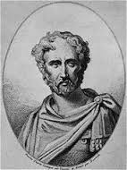
OUT OF AFRICA
2000 YEARS AGO PLINY THE ELDER WROTE
“OUT OF AFRICA THERE IS ALWAYS SOMETHING NEW”
Notes:
The first studies showed that in Zaire and Rwanda AIDS was common and nearly 90% of the sex workers were infected
In Europe and the USA about half the patients with AIDS had come from central Africa and over the following years the epidemiology of HIV 1 infections in Kinshasa would be described in great detail by a group of American Belgian and Congolese researchers
The initial view of Central Africa as the cauldron o HIV-1 was rather naïve based on inadequate facts,
but later research would actually prove it to have been correct but not for the reasons first entertained. Intuition is not always wrong. So what is the story?
I shall have to cut out so many of the details but those interested will find Pinot’s book fascinating reading.

Slide 6
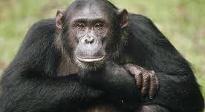
Piecing the puzzle together
Notes:
It starts with the Chimpanzee Pan Troglodytes Troglodytes.
For the past few hundred years it would seem that this ape has been infected with a simian Immuno-deficiency virus SIV-epz this virus is genetically identical with the HIV-1
Such belief is based upon numerous studies among the simian communities of central Africa and by study of the different Chimpanzee types, differing strains of Immuno-deficiency virus have been discovered.
Biologists have studied the behavioral characteristics of the different strains of Chimps and their territories which have often been demarcated because of their inability to swim well and cross large rivers.. Their sexual behaviors have been well documented and despite promiscuity the infection rates have appeared fairly consistent and the infection has been chronic without the devastating effects seen in humans. Possibly Chimps have a degree of natural immunity to the infection and though promiscuous only about 6% of the population is infected. It is clear the other three sub species of chimps are not infected and the smaller strain the Pan paniscus bonobo while less investigated gives no evidence of being infected with the virus.
The HIV-2 strain is a less pathogenic virus and probably came from the Sooty Mandabey Monkey not an Ape.

Slide 7
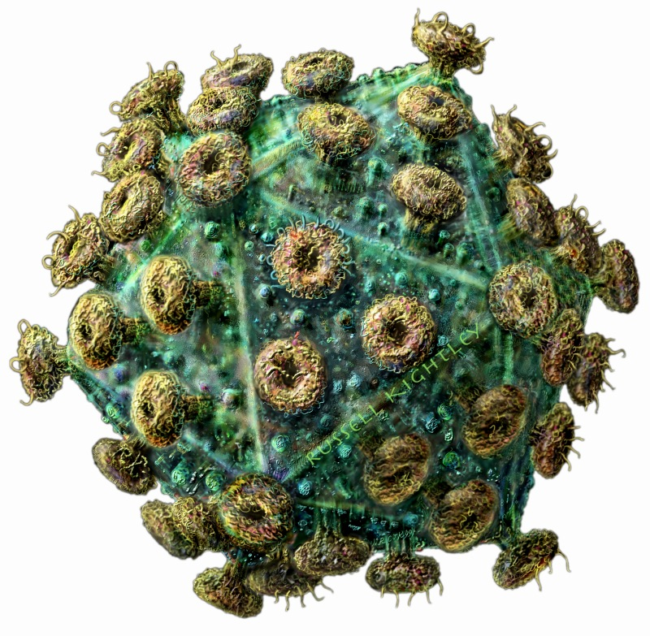
HIV-1
The virus a retrovirus has been extensively studies and has been divided into several sub-types
Notes:
The virus makes mistakes in its reproduction from time to time. The process of mutation is augmented because the virus is replicated at phenomenal rates with billions of viral particles being produced .
This compresses the time required for mutations to occur and increases the odds that there will be a mutation that can persist . This has led to different sub-strains but also to the opportunity to map the spread and the origins from which a specific type may have come.
Basically the P. t. Troglodytes (Chimpanzee) SIV-epz is identical to the HIV-1 so the association seems iron clad.

Slide 8

If Africans and Chimps have been in Africa together for centuries, why the epidemic now??
AMPLIFICATION FACTORS
Notes:
1, Interaction may have been less because before firearms it would have been more difficult to catch them.
2,The populations of Africans were much smaller so fewer interactions.
But there was missing what will be called AMPLIFICATION FACTORS

Slide 9
THE CHIMPANZEE HUNTER
Lets imagine it is 1921 when there is a population of 1.35 million in Central Africa (where the Chimps live)
1.35 million population x 0.1% in contact with chimp blood x 5.9% infected chimps =80 adults exposed to the infected blood this year 1921.
If the transmission rate (based on exposures among health care workers today) was1-3% then there would have been 1-2 men infected with SIV-epz that whole year
Notes:
LET US IMAGINE A CUT HUNTER;
A man goes hunting and kills a chimpanzee but during the course of the butchering sustains a cut with the knife that is bloodied and contaminated by the chimps blood
In 1921 it is calculated there were some 1.35 million human adults living in the areas shared by the Pan T Troglodytes ( Cameroun Francais, Gabon, Moyen-Congo, Oubangui-char, Guinea Espanola, the Cabinda enclave of Angola and that part of the Belgian Cong north of the river)
Let us assume the exposure to Chimp blood was the same as it is today so that 0.1% of these adults had been exposed to chimp blood at least once in their lives. Then if we multiply the total number of adults by this 0.1% and multiply this number by the 5.9% of the infected chimps we can arrive at the number that would have been exposed to the virus while handling a chimp carcass this comes to 80 adults BUT THAT WOULD TRANSLATE TO ONLY 1 OR 2 INFECTED BECAUSE ONLY ABOUT 1% OF SUCH EXPOSURES RESULT IN INFECTION

Slide 10
Without Amplification
These one or two men would have returned to their villages and in traditional lifestyle
Slept with their wives had children and even if they infected their wives and children the family would have died out and there would have been no epidemic.
BUT THERE WAS AN EPIDEMIC AND THERE WERE AMPLIFYING FACTORS
Notes:
Since the Bantu came to central Africa some 2000 years ago they have lived in proximity with the Chimpanzees. It would seem from epidemiological studies on Chimps that their SIV-epz viruses have been around for a few hundred years and there has not been a human epidemic so the scenario sketched on the screen is the most likely one. Something happened!
The typical explanation has been that the virus became more virulent for humans and more able to spread sexually but this does not seem convincing

Slide 11
COLONIZATION
VARIOUS GOVERNMENTS HAD DIFFERING HEALTH PROVISION PLANS FOR THE PEOPLE IN CENTRAL AFRICA AND THE DISEASE BURDENS WERE HEAVY
DISEASES OF CONCERN WERE
SLEEPING SICKNESS
LEPROSY
SYPHILIS
YAWS
MALARIA
Notes:
For all these, parenteral treatments were the preferred treatments.
In fact some of the programs were phenomenal in their energy and scope
Massive iatrogenic transmission of Hepatitis occurred through the efforts to treat with parenteral quinine
Large scale programs for the treatment of Yaws and syphilis in the areas that corresponds to the habitat of the Pan T Troglodytes took place. The incidence of Yaws was of the order of 200/1000 per year in some of these populations between 1920 -1950
So intense was the prevalence of disease and so intense was the response that over a few years the entire population would have been injected

Slide 12
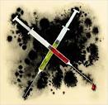
PARENTERAL AMPLIFICATION
REUSING
OF NEEDLES AND SYRINGES
Notes:
Experience with shared needles in the drug using population has shown this to be a highly potent means of transmitting viral diseases.
In fact the literature of the 1920s to 1950’s was replete with descriptions of what were felt to be “serum hepatitis” now known to be Hepatitis B and Hepatitis C
Remember jaundice was the indicator not lab tests so only a fraction of the cases were recognized.
The Belgians for all their faults were prolific health workers and organized huge public health initiatives involving massive forays into the villages where with production line efficiency they would inject the population with various medications.
They were effective in reducing sleeping sickness and also combating leprosy. The use of quinine protected large segments of the expatriate population . The preference among the African population for injections which were felt to be more potent was also a factor but the problem lay in the sterilization procedures.

Slide 13
Reused needles and syringes
Flushing with phenolized water, alcohol or other antiseptics proved inadequate
Hollow needles have been shown to be difficult to sterilize even in the autoclave
Boiling for different lengths of time at different altitudes and when hurried by reason of the large numbers became unreliable too
Notes:
The data on Hep B and Hep C confirmed that there was a lot of contaminated injecting going on
Of course the HIV had not been recognized nor the genetically identical SIV from the Chimp
TODAY we know transmission by needle is 10 times more effective than through sexual intercourse.
The high viremias that occur in the early phases of infection coupled with the repeated injections utilized in the treatment programs ensured even greater opportunities for the transfer of the virus

Slide 14
Romania and Libya
Tragic epidemics relating to the use of blood products long after the HBV, HCV and HIV were recognized have shown the devastating potential of the parenteral injection when using unsafe equipment
In fact the experience in Gabon and Cameroun where some 50% of some birth cohorts were infected with HCV raises irrefutable messages of the danger
Notes:
If HIV were to be in the mix the amplification effect would have been enormous

Slide 15

The HIV-2 Story
This virus comes from the Sooty Mangabey monkey whose territory corresponds to that of the HIV-2 distribution
There is considerable concordance in the RNA sequencing between the SIV-smm (Sooty Mangabey Monkey) and HIV -2
Notes:
IN THE MONKEY THE VIRUS DOES NOT CAUSE DISEASE BUT CAN CAUSE DISEASE IN OTHER SPECIES
There have been 8 groups of HIV-2 identified but only groups A and B manage to spread Human to Human
The sexual spread is less effective and the disease is not as pathogenic as HIV-1
The interesting thing here is that as reuse of needles has stopped we are seeing a decrease in HIV-2 and in fact the population infected now tends to be the older group who would have been infected by the parenteral route
For HIV-2 sexual transmission is therefor a less potent factor.

Slide 16
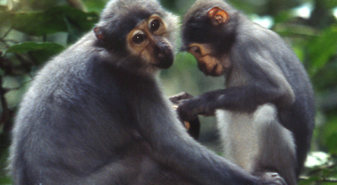
Sooty Mangabey Monkey

Slide 17
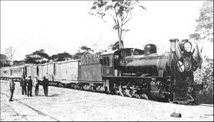
AMPLIFICATION by COLONIZATION
THE CONGO-OCEAN RAILWAY
16% of all males in the Pan T Troglodytes area were conscripted to work for 1-2 years
Notes:
The decision to build this railway while facilitating communications and transport was done in such a way as to become a travesty of the highest order.
Such men were conscripted to work for miserable wages for months at a time, without their wives and without women at the camps except for the so called “free women” these were prostitutes of various kinds.
The risks of this being a factor was considerable because 16% of all males in the area were conscripted to work on this railroad. Let’s assume a significant number of these men had relationships with the prostitutes and that the risk of transmission over a period of some 2 years with repeated contact , other sexually transmitted disease, lack of circumcision, and ongoing parenteral treatments utilizing reused needles was being practiced, and if the virus HIV-1 unlike HIV-2 can be sexually transmitted more readily we have a scenario for the fomenting of an epidemic

Slide 18
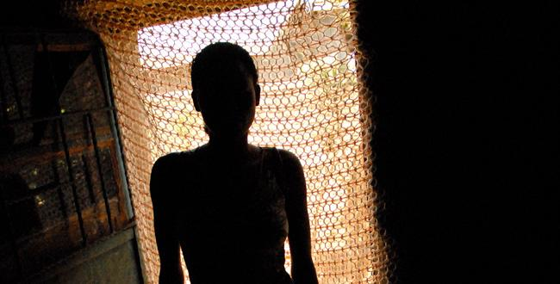
MORE FOR LESS?
THIS SOUNDS FINE UNTIL WE REALIZE
MORE SEX
FOR LESS MONEY
Notes:
Some of the prostitutes could be expected to have over 1000 men they had intercourse with each year and at the low price of a couple of dollars per contact.
To make a living such women were expected to dispense with condoms and of course it was not long before some 90% of prostitutes in Kinshasa were HIV positive.
The political upheavals in Central Africa during the 1960’s continued for several decades with massive movements of people and spread of HIV

Slide 19
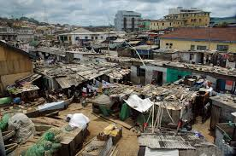
Colonization
But there was far more to colonization than a railway
The cities needed workers.
At first the colonial powers only permitted men to enter
Then the only women permitted were either married or “free women” a name for prostitutes
Notes:
These prostitutes were of different types
Some would attempt to be the mistress of one or more men with whom they consorted on a regular basis but within a closed group these women could command fairly high prices and were envied by others and were able to live generally higher standards of living than the usual woman. They could send home more money and parents would ask few questions when being given larger sums of money than they could have normally expected.
But the days of colonialism were fast coming to an end and huge unrest then began to occur.
The cities with their demographics skewed so there were many more men than women became places where the prostitutes had to increase the numbers of men being serviced to make a living

Slide 20
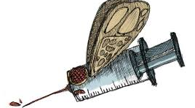
SPREADING THE PLAGUE
Notes:
From Central Africa and its Chimpanzees, its distorted health care with parenteral amplification of viral disease, its shattered demographics and its fractured traditional living the disease spread along the transport routes of Africa.
Into Zambia and from here to the migratory pathways and labor route of Southern Africa.

Slide 21
SOUTH AFRICA
Here we have a country that is economically advanced, but also distorted by apartheid, racism and migratory labor.
People come from all around to the mines
Hostels
Alcohol
Prostitution and
Yes the parenteral factor of reusable needles

Slide 22
South African Politics
Add to this the denial by the Mbeki government that the disease actually existed as a viral illness or that it could be treated and we had a real powder keg

Slide 23
Sexual practices
Preservation of the hymen as an indicator of VIRGINITY
The misguided use of anal intercourse
or of dry sex
All factors in the Epidemic

Slide 24
Moralizing and Stigmatization
Leading to shame
Isolation with hiding of ones status
Reticence to be tested
Hesitancy to admit being positive
Here we all share the blame

Slide 25

Traditional biases
A cultural avoidance of the use of Condoms and our own church proscribing them with slogans such as
“Conduct not Condoms”

Slide 26

CAPITALISM AND THE HIGH PRICE OF H.A.R.T.
MILLIONS DIE FOR LACK OF TREATMENT

Slide 27
FAILURE TO TREAT AS A PUBLIC HEALTH PROBLEM
The Homosexual/Legal lobby stymied the usual responses of universal testing, and treatment. By individualizing care and emphasizing individual rights, they added added a further dimension to this epidemic that might have saved millions of lives had the public health approach including universal testing as in Cuba, been implemented.
It is hard for some of us to admit, that a country like Cuba might have reacted more wisely than the USA.
Weighing individual rights against the public good is always extremely difficult

Slide 28

What of the Faith Based Community?
We must take our share of the blame for adding to the Stigma attached to this disease.
Our sanctimonious and judgmental approach to this disease was out of touch with reality and caused a lot of misery and grief.

Slide 29

Our SDA Church was slow to respond
Our initial response was DENIAL that this was a problem we owned.
Then we added judgment to the mixture.
Eventually we recognized our negligence yet even today we ought to be doing more.
The problem of fatigue begins to show itself in donor withdrawal and apathy.

Slide 30

Billions of dollars later
Where are we now? And what will happen next?
One very important message out of ALL of this is that our best intentions may often lead us astray and we need to be constantly vigilant

Slide 31

The Slow Medical Community
Hopefully soon Universal testing and Treatment of ALL at risk persons will occur, with resultant lowering of the current massive viral loads
This could result in an exponential decline in the transmission of the virus with a consequent decline in new cases.

Slide 32
We have much to fear for the future if we neglect to learn the lessons of the past!

Slide 33


